Slide 1
Transforming a Media Organisation with Big Data
Robin Goad, Head of Customer Analytics, Financial Times
March 2016

Slide 2
Agenda
A brief history of the FT
What does Big Data mean to the FT?
The benefits of Big Data
How we do it
What’s next?
2
3
4
5

Slide 3
A brief history of the FT

Slide 4
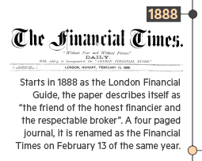
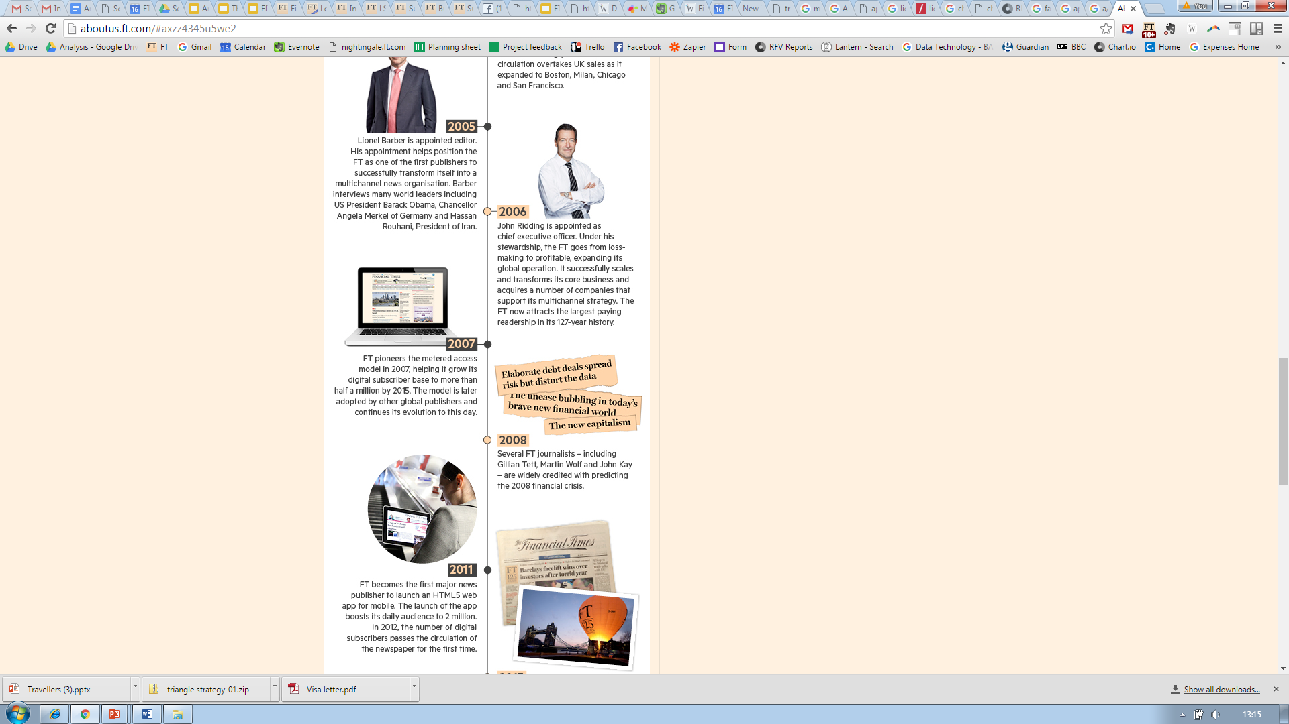
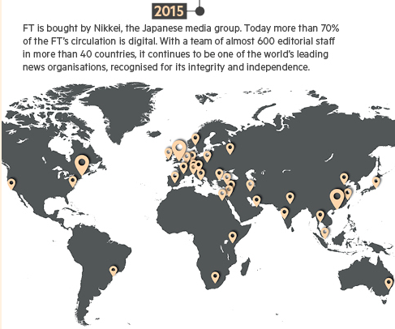
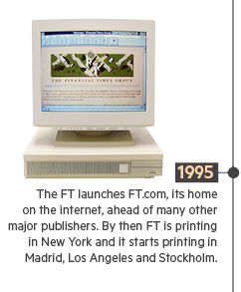
128 years of innovation

Slide 5
What does Big Data mean to the FT?

Slide 6
The data that matters
User
Identity
Demographics
Behavioural
What is read?
How is it read?
Meta
What is the story about?
Who wrote it?
Devices
Payment
Permissions
Contact
Subscription
Where is it read?
How is it found?
Why is it read?
What about stuff that isn’t read?
Where does it belong?
When, where and why was it published?
Who can see it?
Notes:
Emphasise the importance of collecting and storing data

Slide 7
“80% of the FT’s revenue would be at risk if we lost our First Party Data”
Internal analysis to determine the value of the FT’s First Party Data

Slide 8
The benefits of Big Data

Slide 9
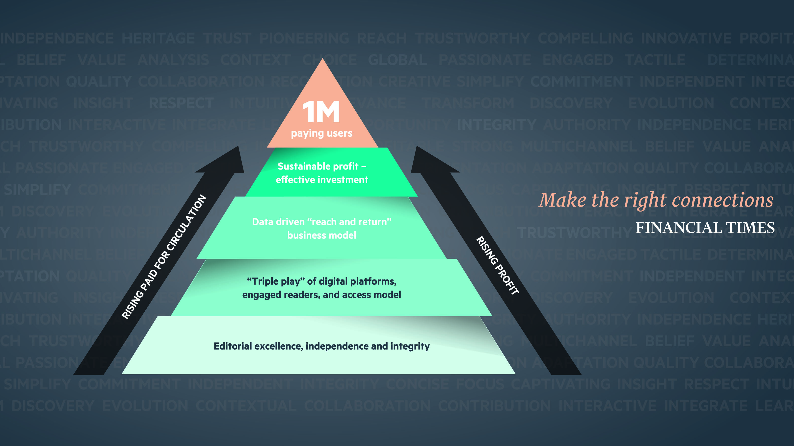
A data driven strategy
Notes:
Data driven strategy

Slide 10
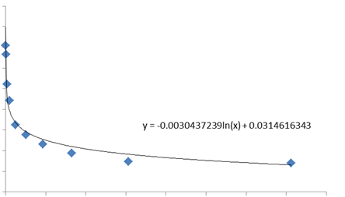

Measuring Reader Engagement
We look at reader behaviour over the last 90 days:
Recency – when did they last visit?
Frequency – how often do they visit?
Volume – how many articles have they read?
More engaged readers are less likely to cancel
Cancellation rate
Engagement score

Slide 11
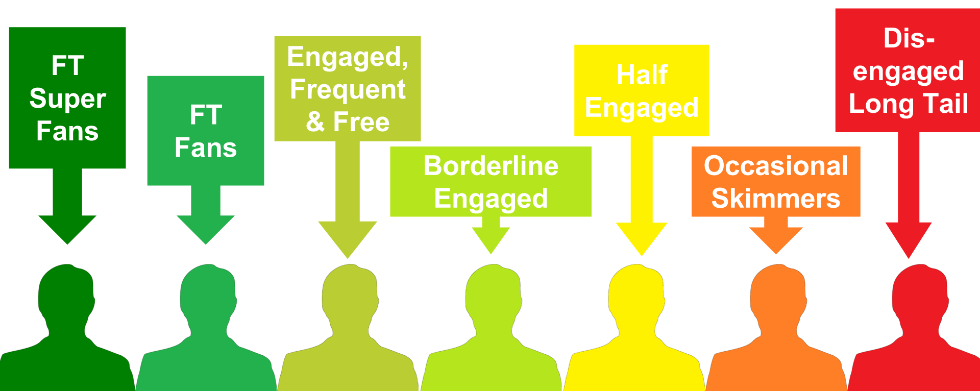
Segmenting users based on behaviour

Slide 12

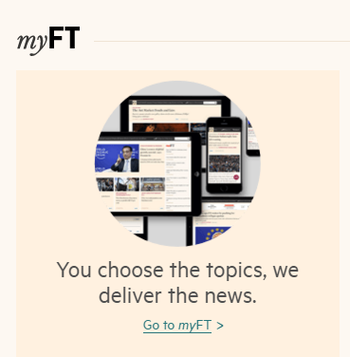
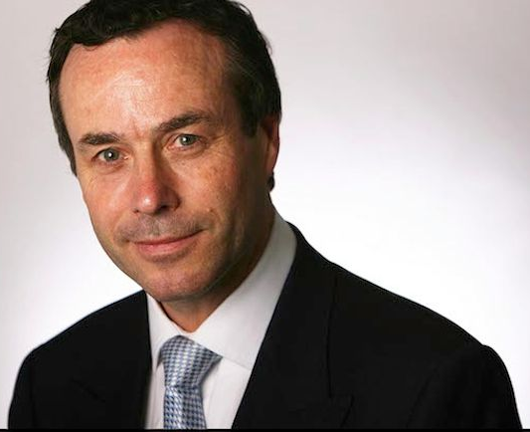
Personalisation via data
myFT – peronalised content on- and off-site
API – feed data to where people need it
Editorial authority
Notes:
% of traffic from homepage
Use of lionel on barriers etc – wins on A/B tests

Slide 13
Data driven innovation

Slide 14
How we do it

Slide 15
Team and organisational structure
Key supporting functions:
Chief Data Officer
Customers of
Data and Analytics
Analytics
Technology
B2C and B2B
Product
Reporting
Data
Intelligence
Data
Science
Vertical
Specialists
Editorial
Research
Product
3rd parties
Campaign Management
Finance
Data Strategy
Advertising
Board & Strategy

Slide 16
“The analytics team (with support from tech, commercial and third parties) will explore ways of finding value as a prerequisite to building in new capability”
The FT’s “Analytics First” approach to Big Data

Slide 17
What’s next?

Slide 18



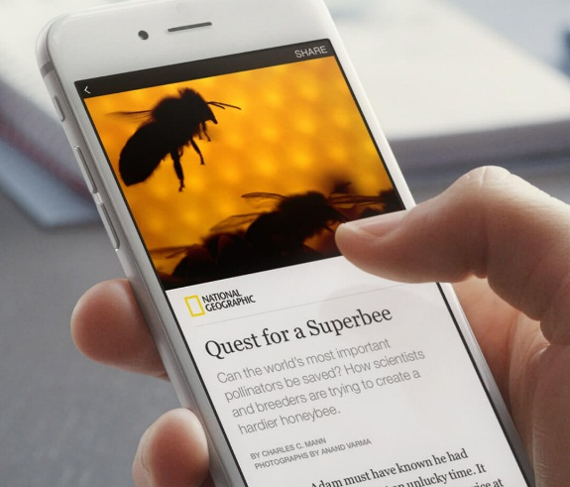
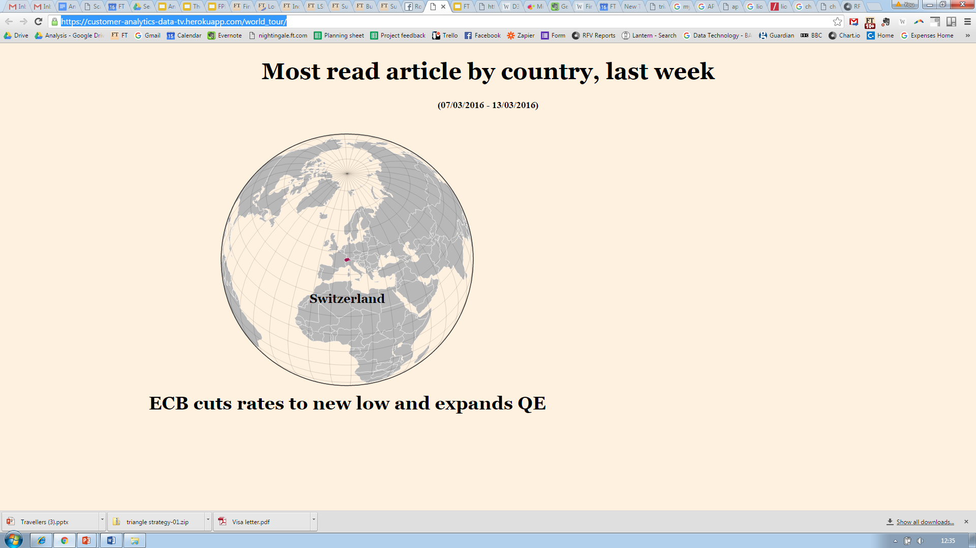
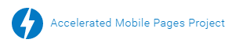

What are we planning for 2016?
Data democratisation
Distributed content
Plus…
New data sources
Focus on data quality
Answer questions quicker
Develop new skills
Grow team
More stakeholders
Academic partnerships
More innovation…
Test, test, test…

Slide 19
Questions?

