Slide 2
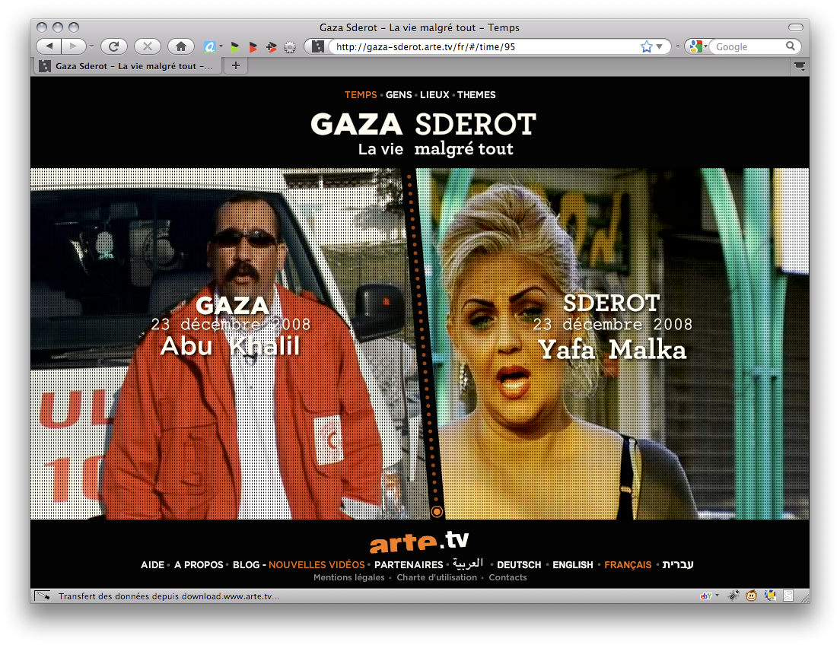
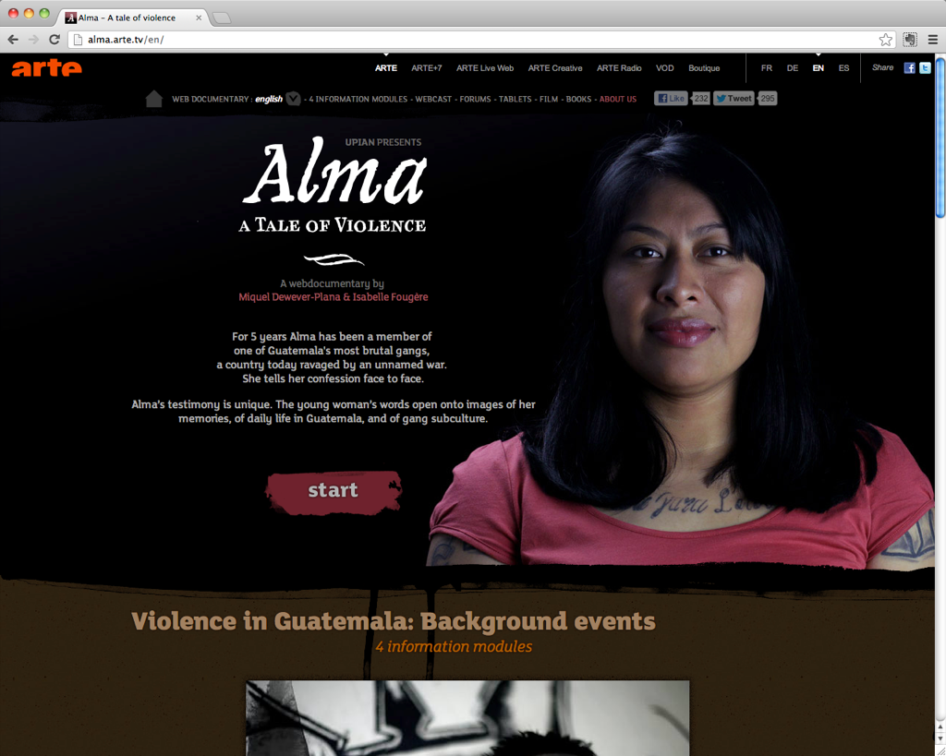

Slide 4
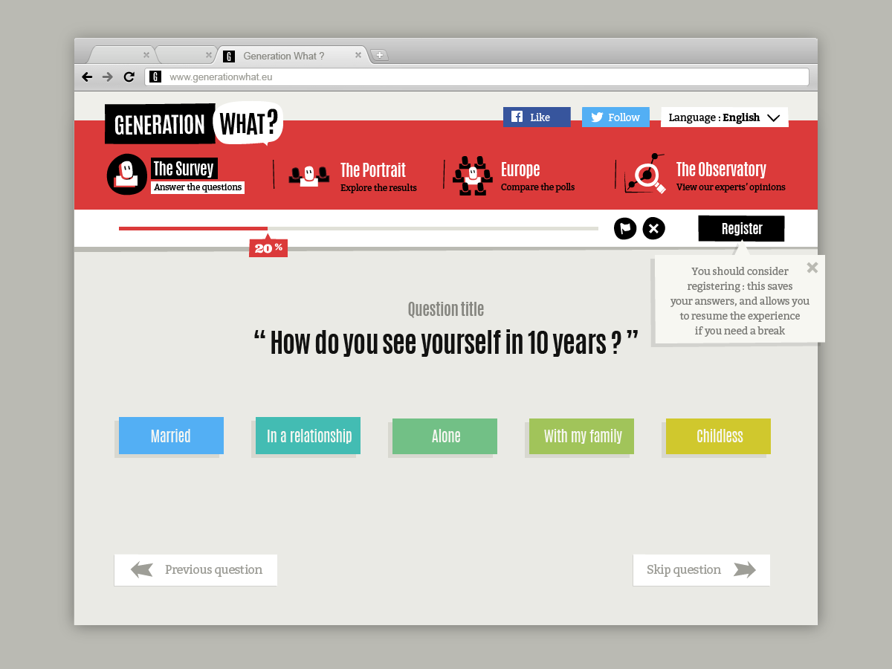

Slide 5
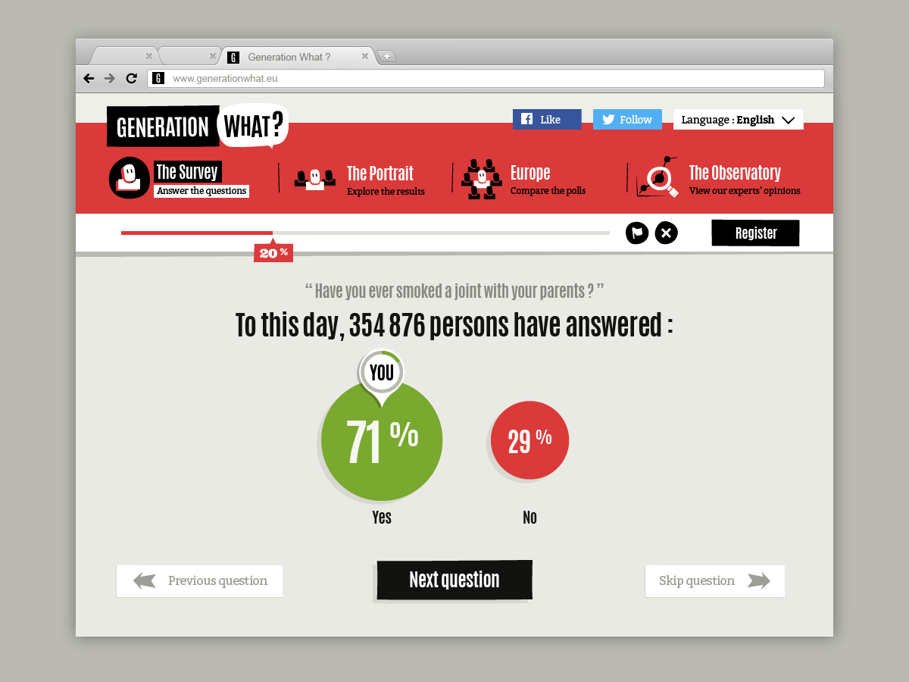

Slide 9
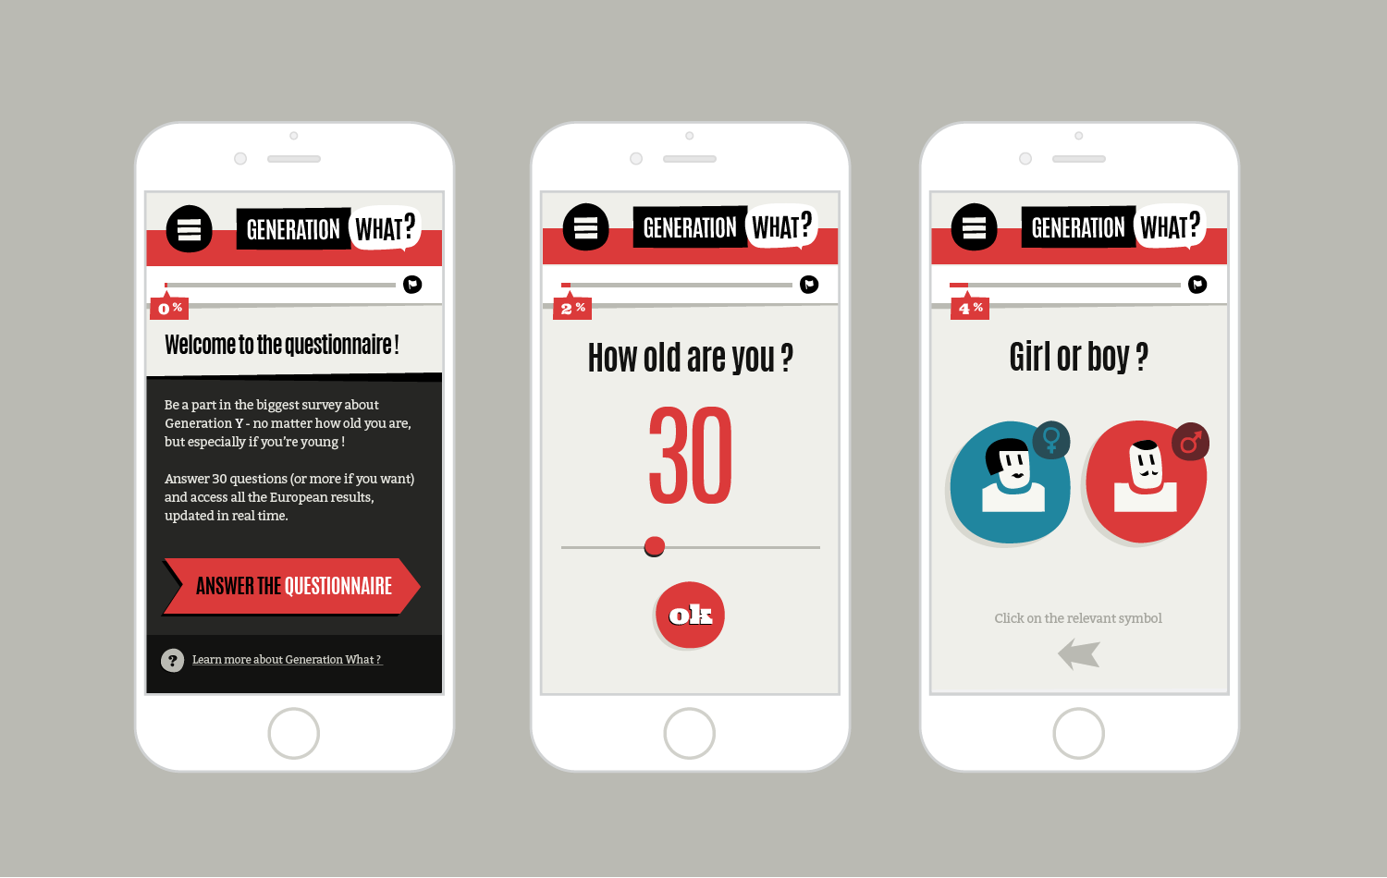

Slide 10
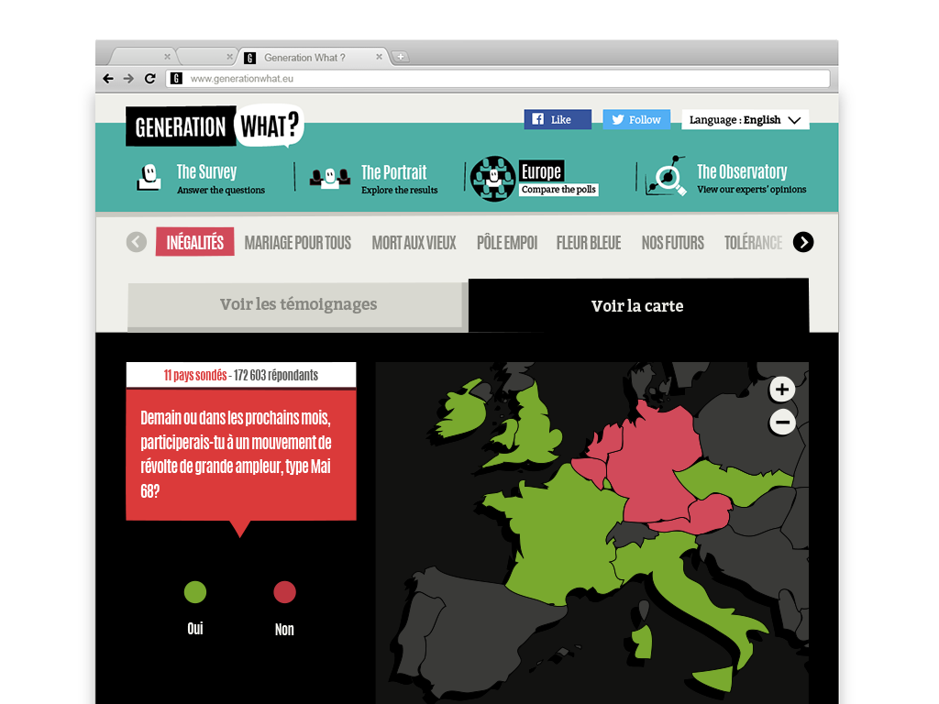
An interactive documentary collection

Slide 11
A BIT OF BIG DATA
Total French respondents : 251,675
Female : 143,470
Male : 108,205
18-34 years old: 220 378
workers: 127 845
student: 92 533
Total Answers : 22 209 144

Slide 12
A BIT OF BIG DATA
Banks and money rule the world
90% say yes
But 2/3 think that politicians still have power…
Do you trust in politics
only 1% says "Yes totally", 13% "Yes most of the time".
86% say "No" (46% not at all, 40% not so much)
Do you trust the medias
"Not at all": 41%, "Not so much": 46%
"Yes a bit": 13%, only 1% say "Yes totally"
Do you trust Europe
"Yes totally": 8%, around 37% in the middle (yes some time and not so much),
only 18% say "Not at all »

