Slide 1
Big data – a game changer for PSM?
Day 2 – workshops
Personalisation and recommendations
Where are we?
(some live notes and impressions)
Jean-Pierre Evain, EBU

Slide 2
Big data – where are we?
The interest for big data is there
Participation of early adopters such myRTS, myBBC
Workshop participants have indicated management support
Of course, the success of the conference itself is an evidence of the interest
Although personalisation and recommendation are not new concepts, technology is now mature enough (enablers)
SSO / CPA for user identification
Big Data analytics tools (but has an important human dimension)
Storage technologies and processing power.

Slide 3
How far can psb go?
Hard to define, not one simple single answer
Narrow the offer of personalised content to the extreme, even if right on the money, is not a reasonable goal (resulting in narrowcasting, closing profiles going against discovery)
Propose editorially controlled content fitting user preferences (to a certain extent?) with a richer offer is more appropriate
Also allow editor’s push to fulfill PSB’s mission in line with their values incl. information and education using the same technology but for a different purpose. It cannot be personalisation and recommendation only but a balanced mix.
Help discovery of new content is important

Slide 4
Handle with care
The notion of “limpidity” towards the audience is key (whether data is collected via cookies or login profiles. The right to be «forgotten» is vital. Resetting profiles should be easy.
We need to set reasonable expectations against the promises, which will require good KPIs for an objective assessment of the technology before suggesting our members a full strategic migration as data-driven organisations. Such PKIs may not be easy to identify. Important to share good and bad practices.
However, even at different level of experimentation or implementation we still seem to be at the beginning of the Big Data "hype cycle“ (see next slide). Proving the value of the proposition will require significant investment (new organigram, new skills, integration) and associated risk assessment. "

Slide 5
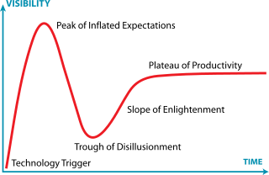
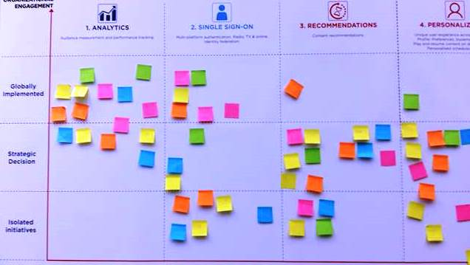
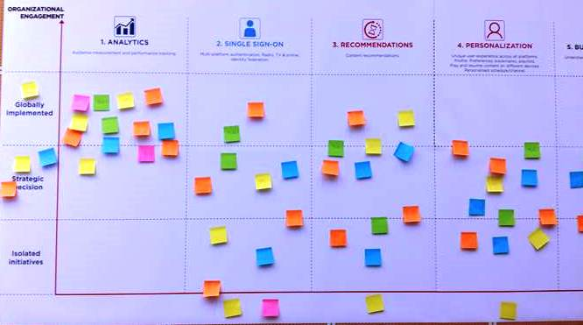
Big data: buzzword, hype or more?
(already blended ☺)
Enablers:
CPA, analytic tools and skills

Slide 6
I almost forgot…
Knowing user A is watching something somewhere is good.
Knowing user B with a similar profile has been watching something else that could be of interest to user A is also good.
But knowing what they have been watching, or NOT,
is also vital as reminded by some workshop participants!
Metadata used to be referenced as the “Queen”
but now metadata is KING

Slide 7
Big data – a game changer for PSM?
Contact
Jean-pierre Evain
evain@ebu.ch

